Slide 1
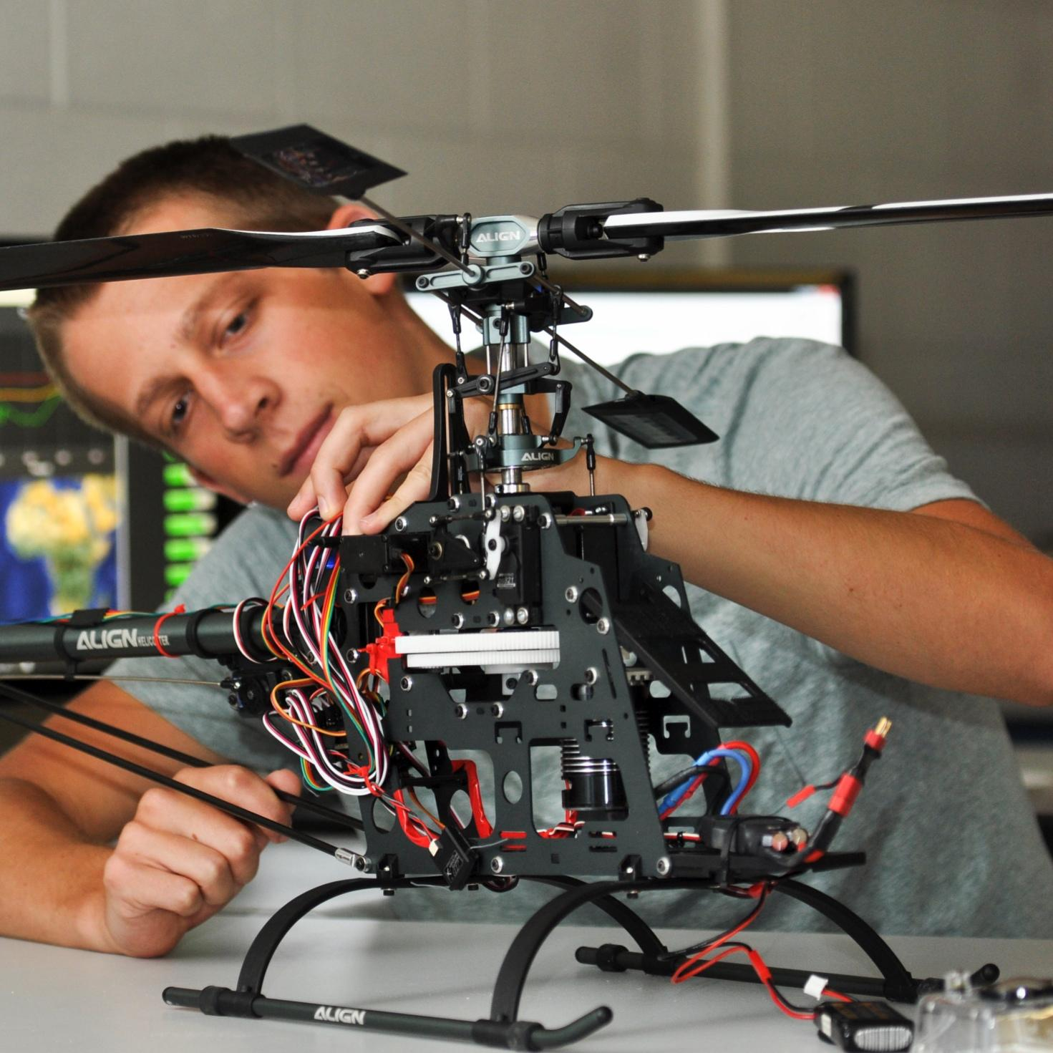

TMEIC DI-Water Cooling Skid
Bi-Weekly Update 3
Ethan Henderson
Robert Parker
Noah Ovikian
Sponsor: TMEIC
TA: Jerry Xu
Notes:
Michelle

Slide 2
Project Summary
Problem Statement
TMEIC’s high-power VFDs rely on deionized-water cooling to protect inverter IGBTs from damaging heat. Using a full-scale cooling system for customer training is costly, cumbersome, and impractical, yet trainees still need realistic operating and troubleshooting scenarios.
Our Solution
We are designing and building a compact, temperature-controlled DI water cooling skid for TMEIC’s training facility. It will reproduce the behavior of the full-scale system, enabling accurate hands-on testing, diagnostics, and troubleshooting at a fraction of the scale, cost, and complexity.

Slide 3
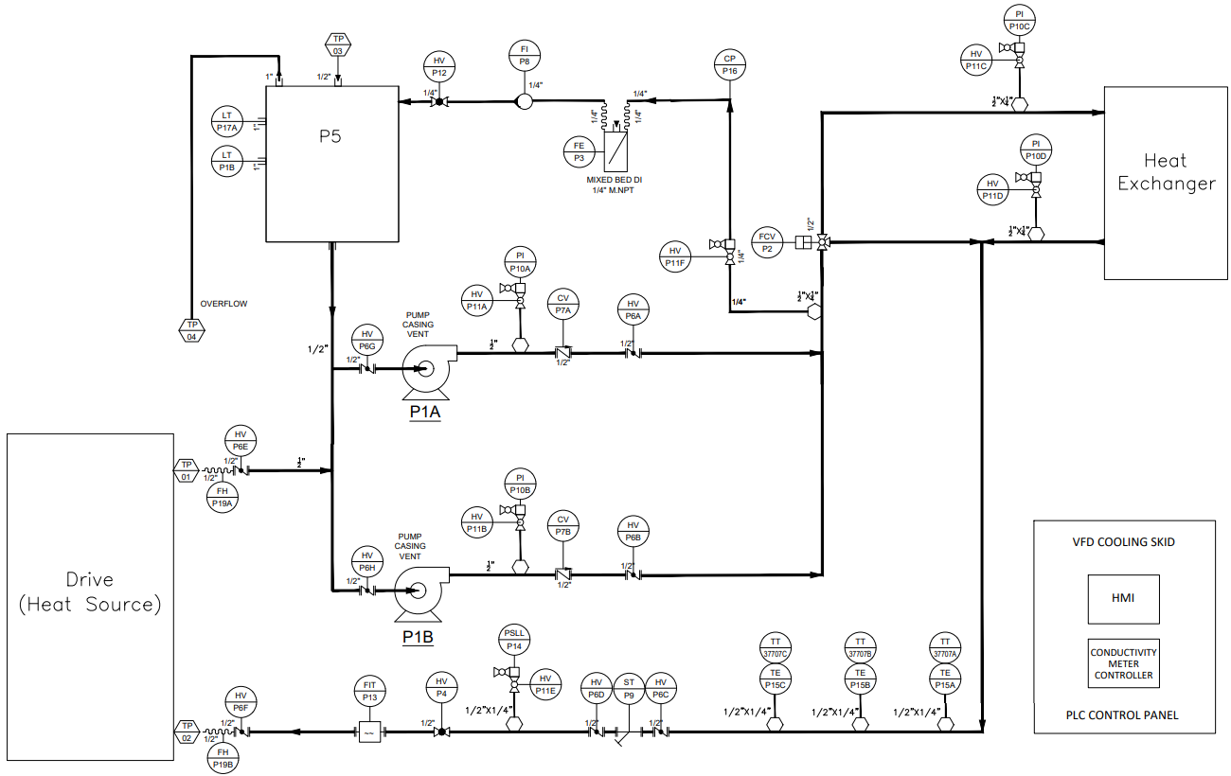
Project Summary

Slide 4
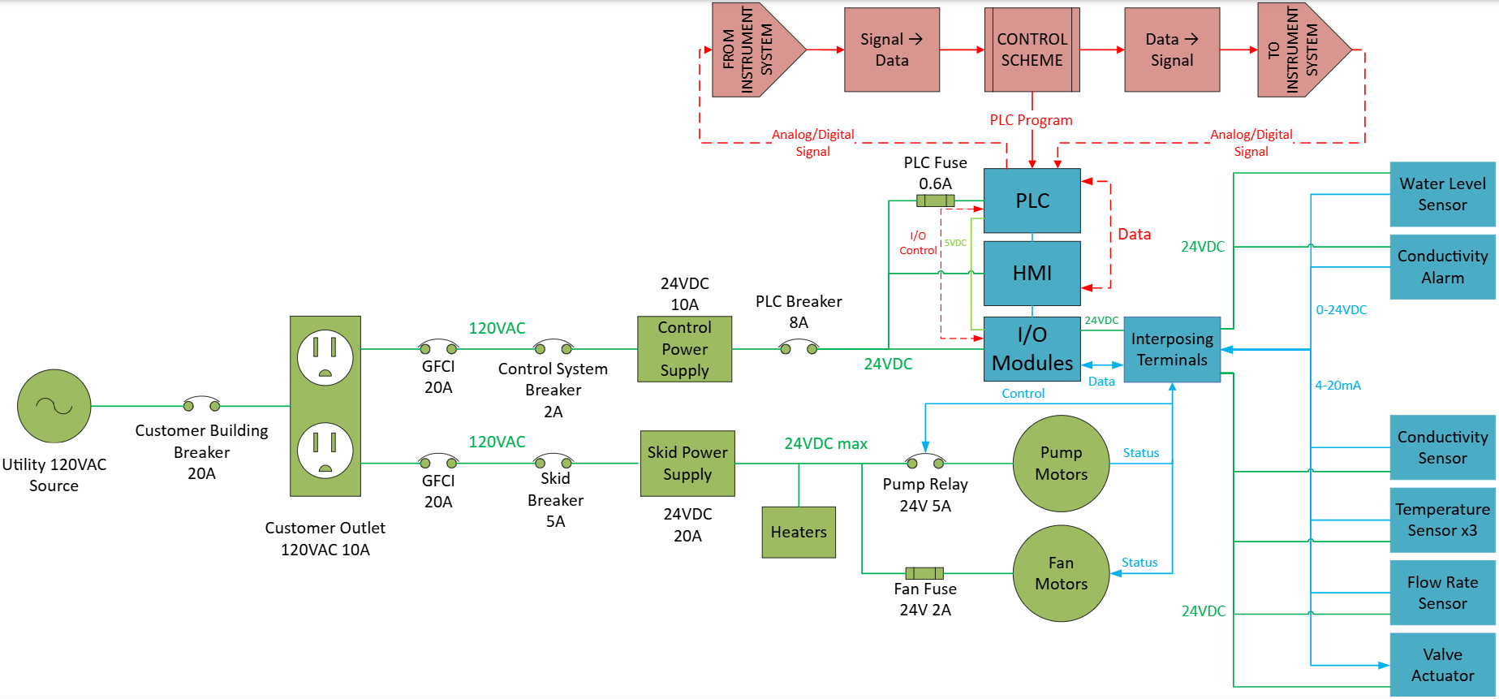
System Overview
Ethan Henderson
Robert Parker
Noah Ovikian

Slide 5
Phase II Timeline
SEP 17
ALL Electrical Equipment Received
SEP 25
Phase II Skid Construction
Resin filtration loop
NOV 1
Phase III Construction Start
Heating/cooling loop
SEP 24
OCT 1
SEP 17
SEP 24
Phase I Testing Complete
Phase I Skid not completed on time
SEP 25
OCT 1
Phase I Test Reschedule
Phase II Testing Start
Resin loop head loss and conductivity validation
NOV 1
Complete
In Progress
Behind Schedule
Not Started
*Contains AI generated content*

Slide 6





Parts Ordering Status
Received
Pumps
Conductivity probe
Control system
RTDs
Pump relays
Fan relay
Power switches
Current probe
Voltage probe
Pressure switch
3-way valve
24VDC 10A PS
24VDC 20A PS
600mA fuse
1A fuse
DIN rail
14 AWG wire
Flow transmitter
FEDC
J. CAIN
The Void

Slide 7
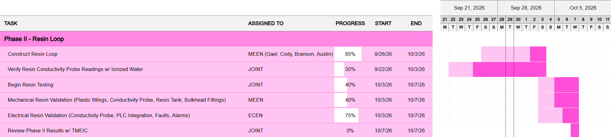
Execution Plan

Slide 8
Power | ECEN Team Lead
Ethan Henderson
Accomplishments (9/16 - 9/30) | In Progress (9/30 - 10/14)
Established new agreement for multiple days of water testing Coordinated new strategy between ECEN and MEEN regarding Phase construction and testing delays Received ALL power components on BOM Constructed full power system prototype with all available loads mapped out intermittent connections understood DIN rail real estate for PLC box mounting recognized best practice for wiring established grounding plan (pending test) | Continue working to provide clarity on project-class requirements and expectations Be more involved in MEEN Phase construction timeline to better prepare ECEN for testing Isolate ECEN group from MEEN’s more volatile timeline - focus on getting the electrical system in a plug-and-play position Finalize wiring diagram (length, position, color, AWG, etc.) and component DIN rail mounting Mount and ground electrical system in PLC box Reassess AC protection scheme due to additional AC load Reassess Skid Power DC protection due to additional motor load

Slide 9
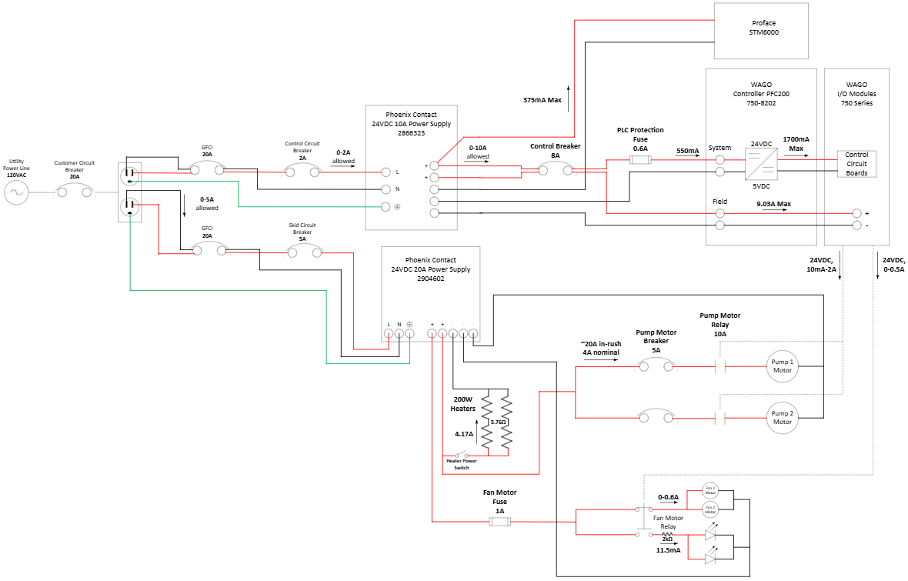
Power System
The power system was redesigned to expand from two to three power supplies (two 10A and one 20A) to improve power distribution and accommodate system requirements, while branching circuits were terminated at intermittent terminal connections to provide the necessary electrical connectivity and improve overall system integration.
Figure P.1.1: Power system (8/24)
OLD

Slide 10
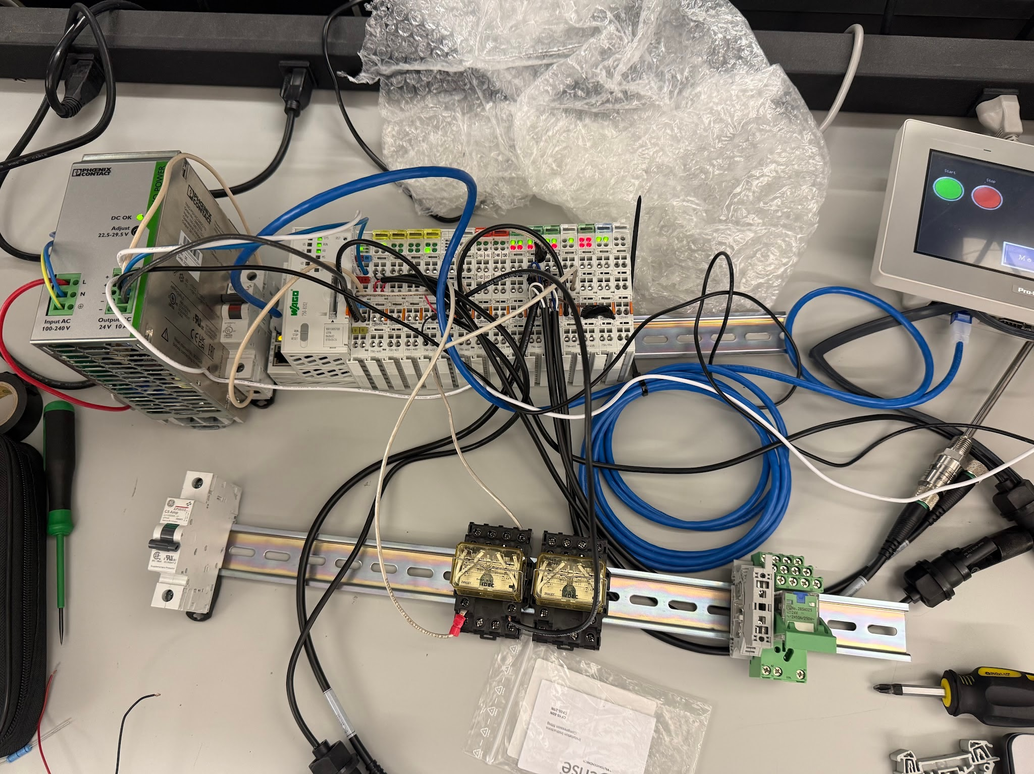
Power System
Figure P.1.2: Photo of Power system (8/24)
OLD

Slide 11
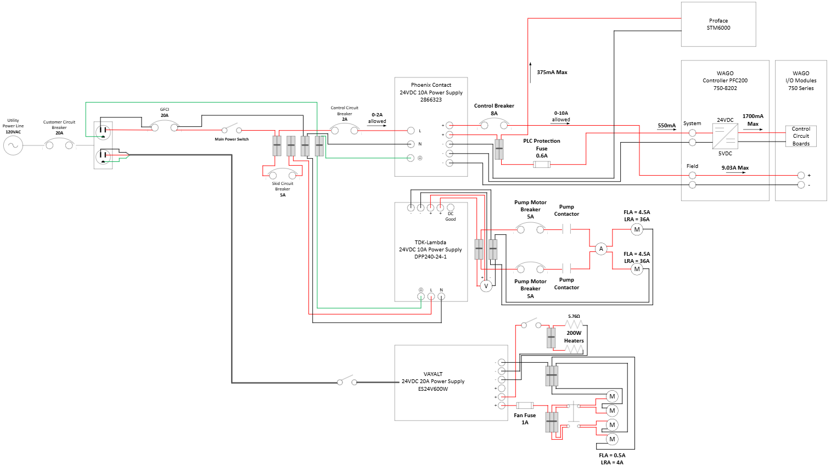
Power System
The power system was redesigned to expand from two to three power supplies (two 10A and one 20A) to improve power distribution and accommodate system requirements, while branching circuits were terminated at intermittent terminal connections to provide the necessary electrical connectivity and improve overall system integration.
Figure P.2.1: Power system (9/30)
NEW

Slide 12
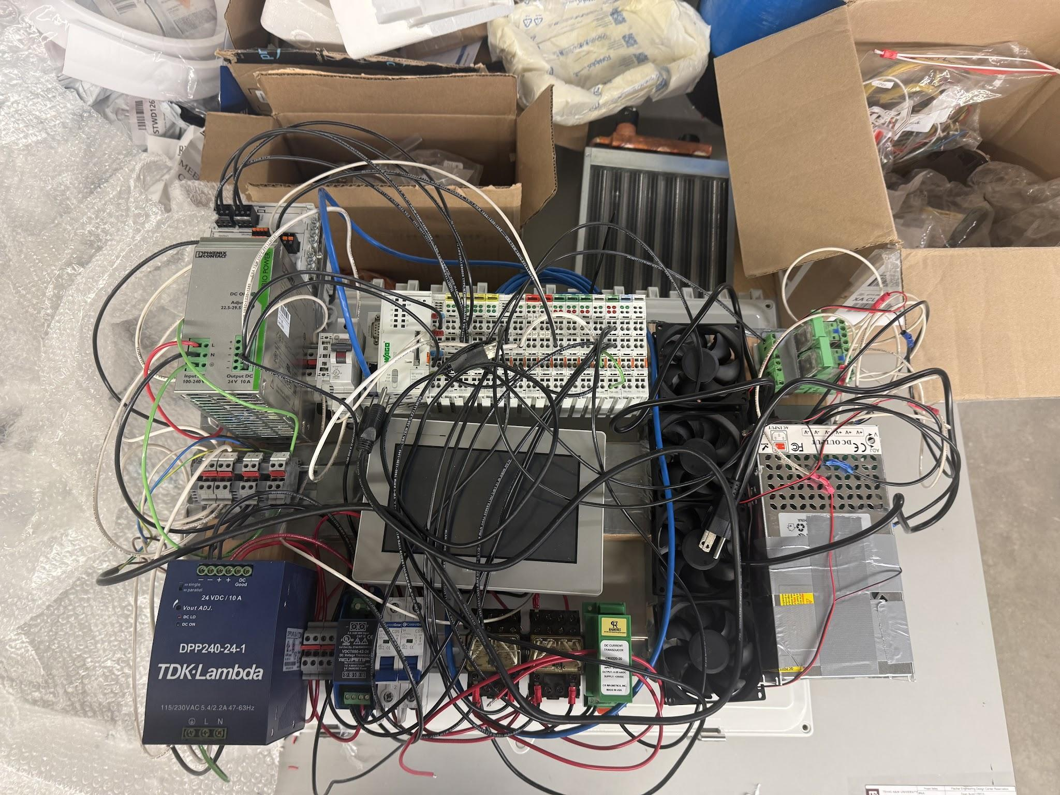
Power System
Figure P.2.2: Photo of Power system (9/30)
NEW

Slide 13
Control Hardware
Robert Parker
Accomplishments (8/31 - 9/16) | In Progress (9/16 - 9/30)
Tested and Installed Power Monitor transmitters and valve actuator Refactored HMI overview screen Installed and tested Pump and Fan control Relays | Test Conductivity Meter Part of Phase 2 build I/O to PLC is tested only need to test probe measurement Phase 1 build and test Install float switches to reservoir Test Control of Pumps via digital out to relays Test Flow Meter with Phase 1 build (Blocked until flow meter arrives)

Slide 14
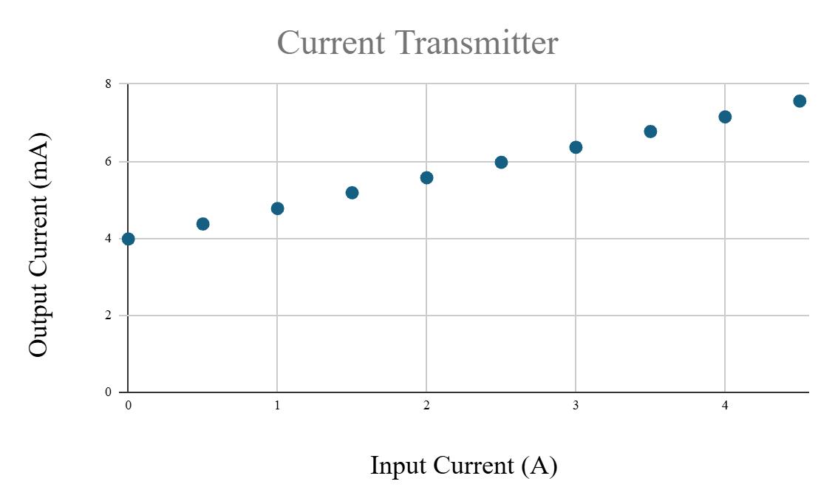
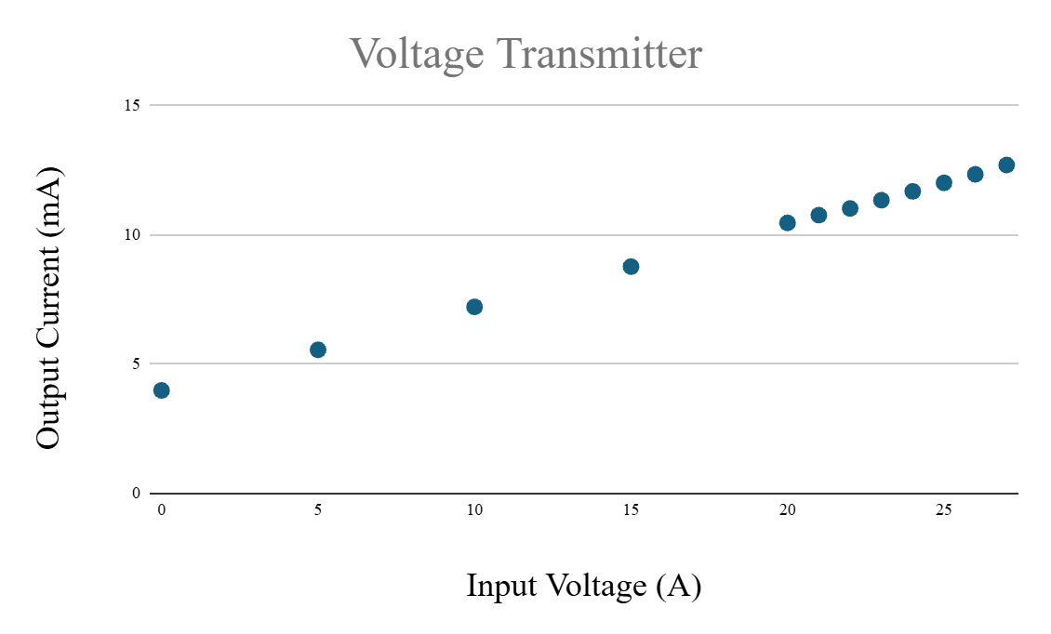
Control Hardware
Power Monitor Testing
Testing shows that output of power monitors is a linear relationship
Figure CH.1: Plot of Signal Current vs Test Current
Figure CH.2: Plot of Signal Current vs Test Voltage

Slide 15
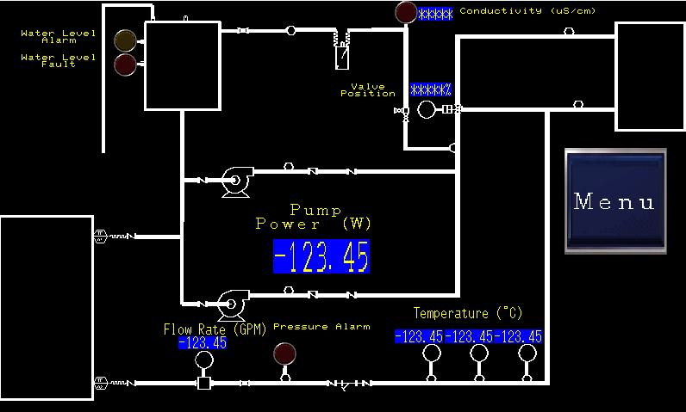
Control Hardware
New HMI Overview Screen
New Screen has P&ID to Show Where each Measurement Is Coming From
Figure CH.3: New HMI Overview screen

Slide 16
Control Software
Noah Ovikian
Accomplishments (9/16 - 9/30) | In Progress (9/30 - 10/14)
Digital Twin Sized Hydraulics & Temperature Components Implemented PID Controller w/ regulators Validated PID Regulation & Robustness PLC Logic / Integration Mapped MODBUS & I/O Variables Implemented Diagnostics Phase Validated Pump Control & System Configuration | Control Strategy Potential return to PID Control (confirm w/ sponsor & MEEN) Digital Twin Experiment with derivative gain implementation Analyze system dynamics w/ various orifice openings. PLC Logic Implement Cascading Control Loop Validate Valve Position Feedback Integration Establish Connection & Control w/ 3-Way Valve Validate Reservoir Level Control Verify Analog Scaling

Slide 17
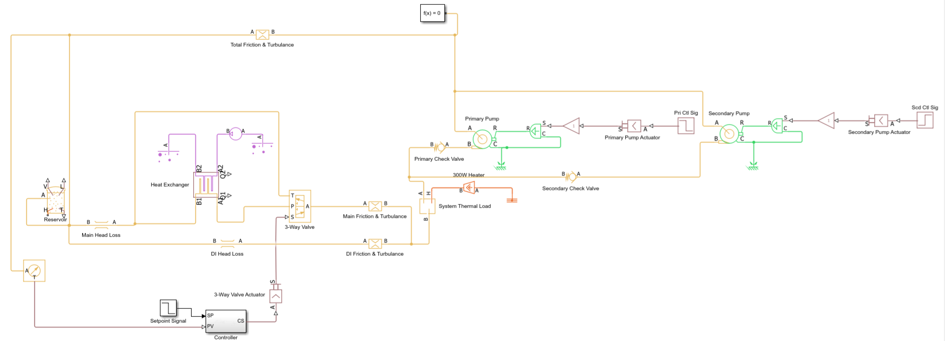
Control Software
Updated Digital Twin
Figure CS.1: Updated Digital Twin Model. Head losses, friction, and turbulence within digital twin subsystems (color-code legend left), accounted for through pressure drop & restriction blocks in circuit

Slide 18
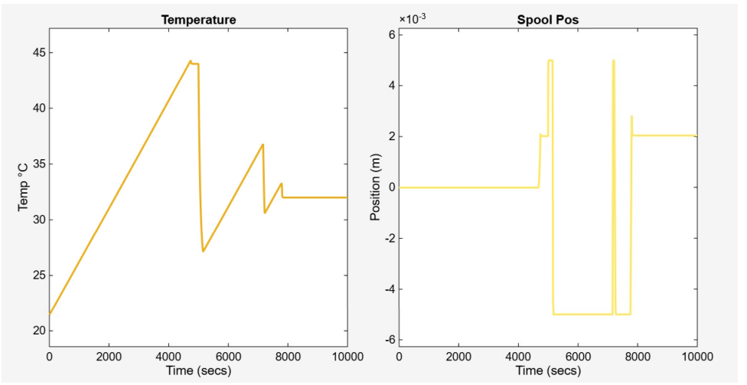
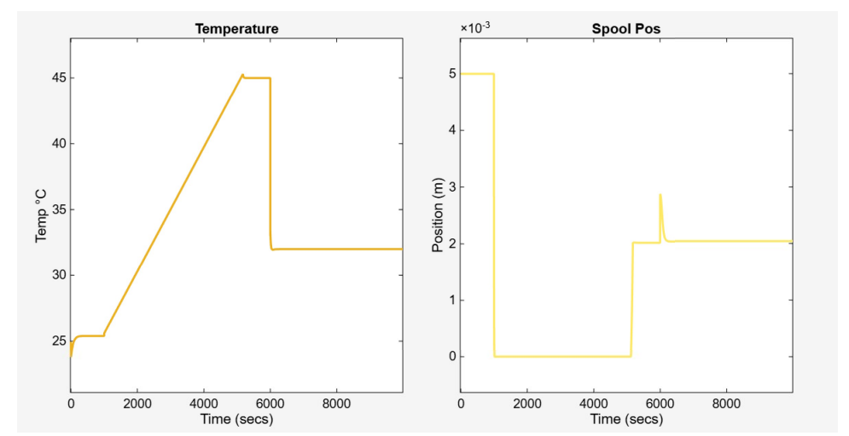
Control Software
Digital Twin - ROI
The Digital Twin is a tool developed in response to delayed physical testing
Saving time through virtual experimentation
Preventative instead of Reactive Measures
Physical Testing with a priori knowledge
Simulation Return on Investment Include:
  Hysteresis Control
  Initial Transient Response Strategy
  ΔSP Regulation Algorithm
  PID Controller Tuning
  Dynamic Hydraulic Regulation Algorithm
Figure CS.2 Example of using simulation to test & validate system: (Top) PID response without ΔSP (setpoint) regulation. (Bottom) PID response with ΔSP regulation. Spool pos (position) controls position of orifice in 3-way valve.

Slide 19
Control Software
Digital Twin - Validation
Table CS.1 Comparison of calculated MEEN and simulation results. (100% HX Throughput)
Measurements | Simulation Value | Calculated Value | % Difference
Total Loop Flow (GPM) | 5.9129 | 5.9 | 0.218405303
DI Loop Flow (GPM) | 0.9061 | 0.9 | 0.675488622
Main Loop Flow (GPM) | 5.0069 | 5 | 0.137904846
Steady State Temp (°C) | 25.3948 | 26.87 | 5.64509957
Pump Outlet Pressure (Gauge PSI) | 8.3829 | 8.23 | 1.840738222
Pump Inlet Pressure (Gauge PSI) | 0.2245 | 0.21 | 6.904761905
Calculated values obtained from MEENs
All flow directed into heat exchanger loop through out simulation duration
Simulation & calculated value differences within tolerable ranges

Slide 20
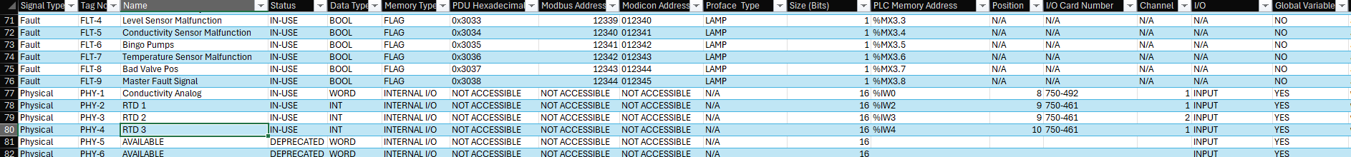
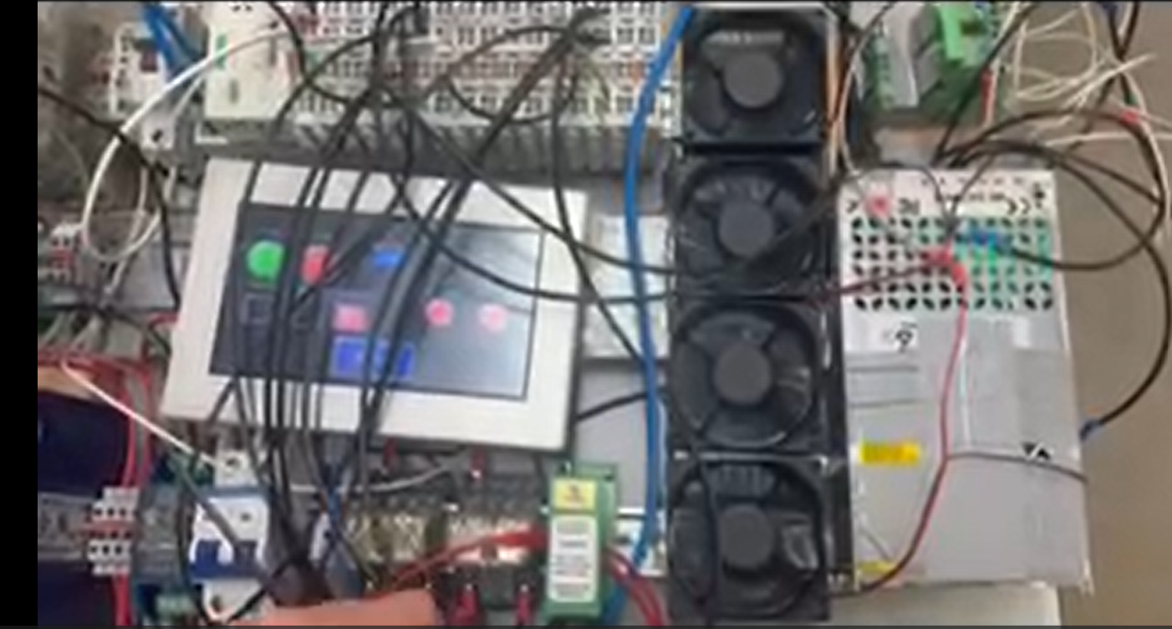
Control Software
PLC Point List
Figure CS.3 Snapshot of of PLC Point List. Subset of Fault & Physical Signals
Fundamental Key for Software & Hardware Comms.
Automatic Addressing in Excel Sheet for modifications
Necessary for Physical Control System Validation
Figure CS.4: Configuration screen on HMI: Lights & Buttons mapped w/ PLC Point List. Excuse potato quality picture

Slide 21
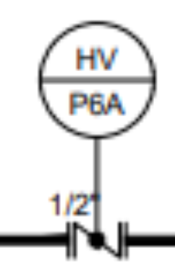
MEEN Integration
Phase II
DI Water
Tank
Bucket

Slide 22
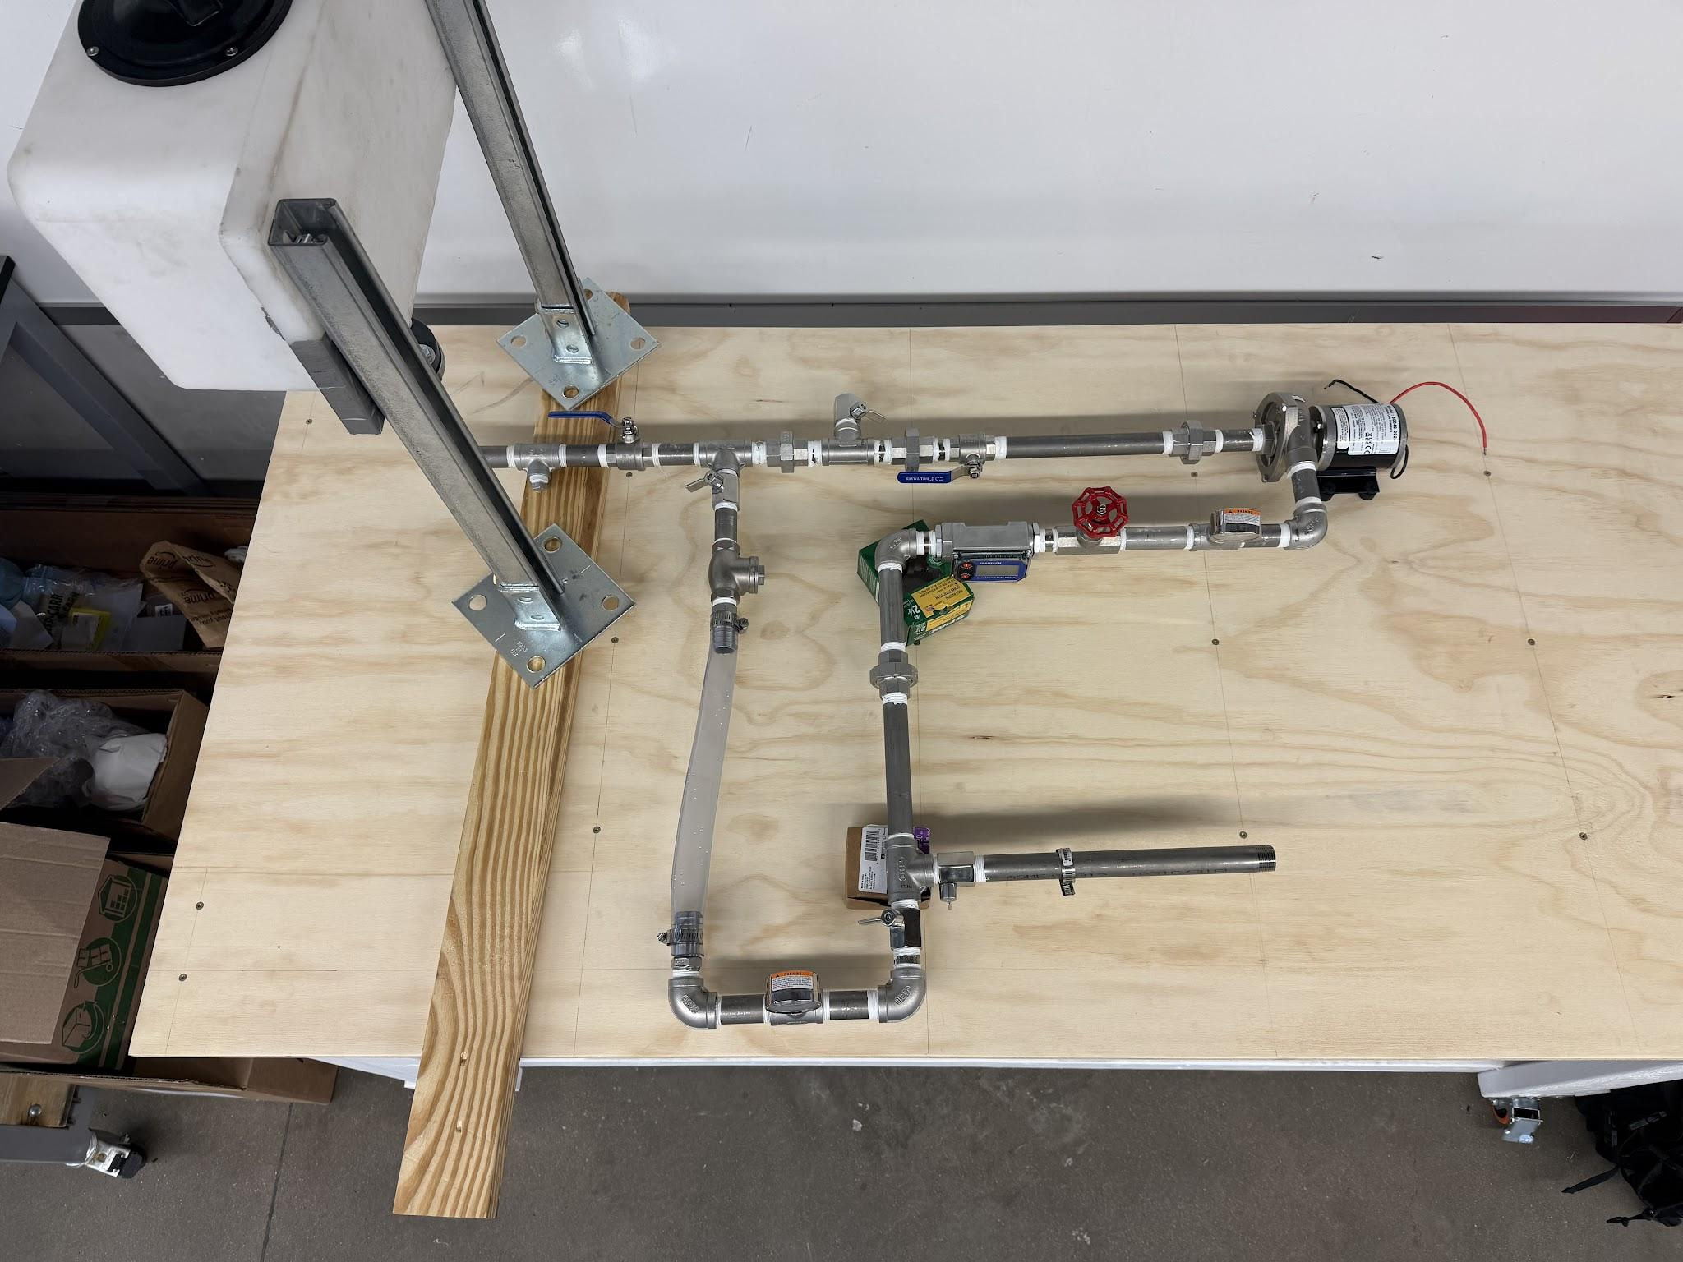
MEEN Integration
Phase II

Slide 23
Thank You

